Slide 1
Jim World
Nicholas Vo, Vincent Park, Nicholas P., Minjae Son

Slide 2
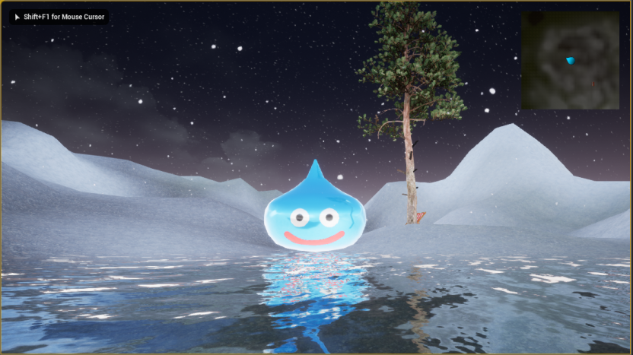
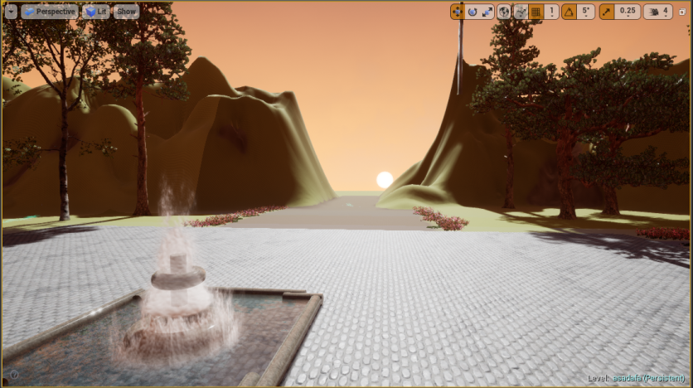
Jim World
JRPG with a Turn Based Battle System
“Race against the clock” story
Based on day/night cycles in game
Discourages grinding
Incentivises tactical approach
Emphasis on art and story

Slide 3
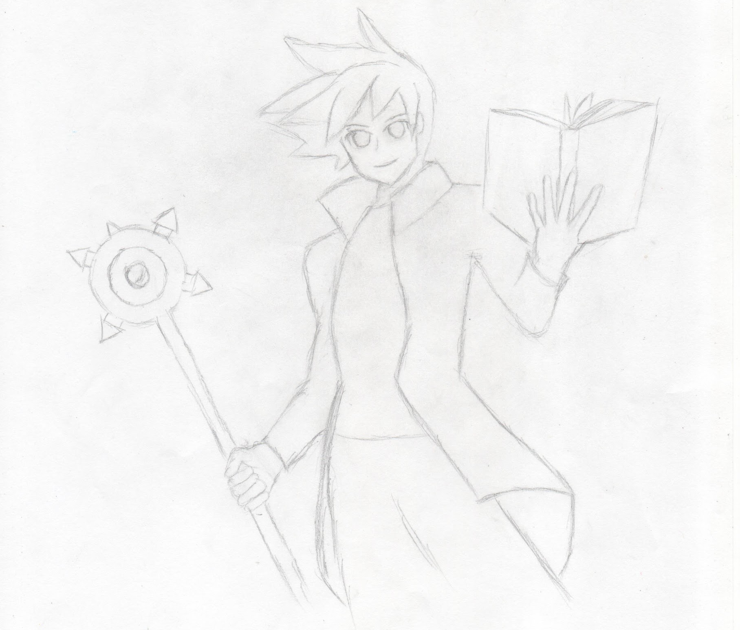
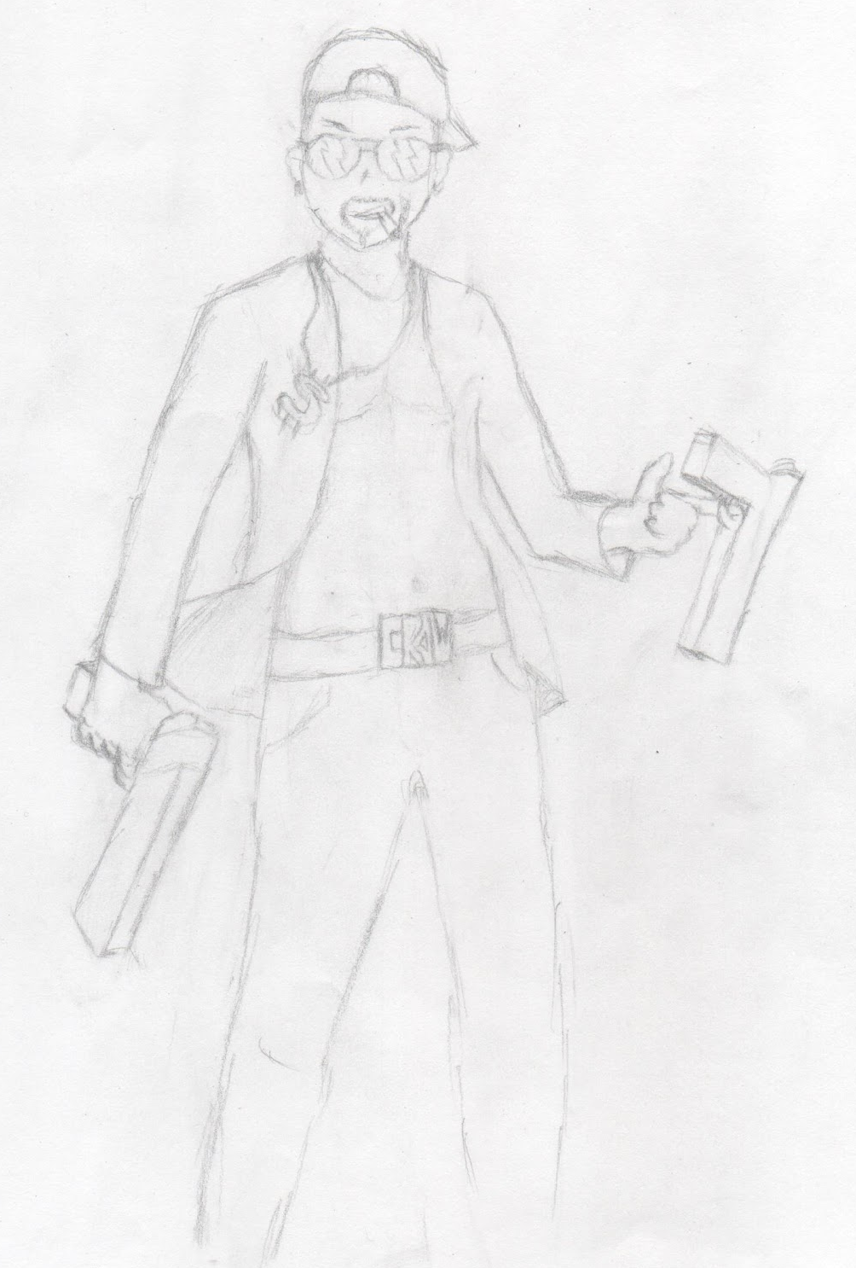
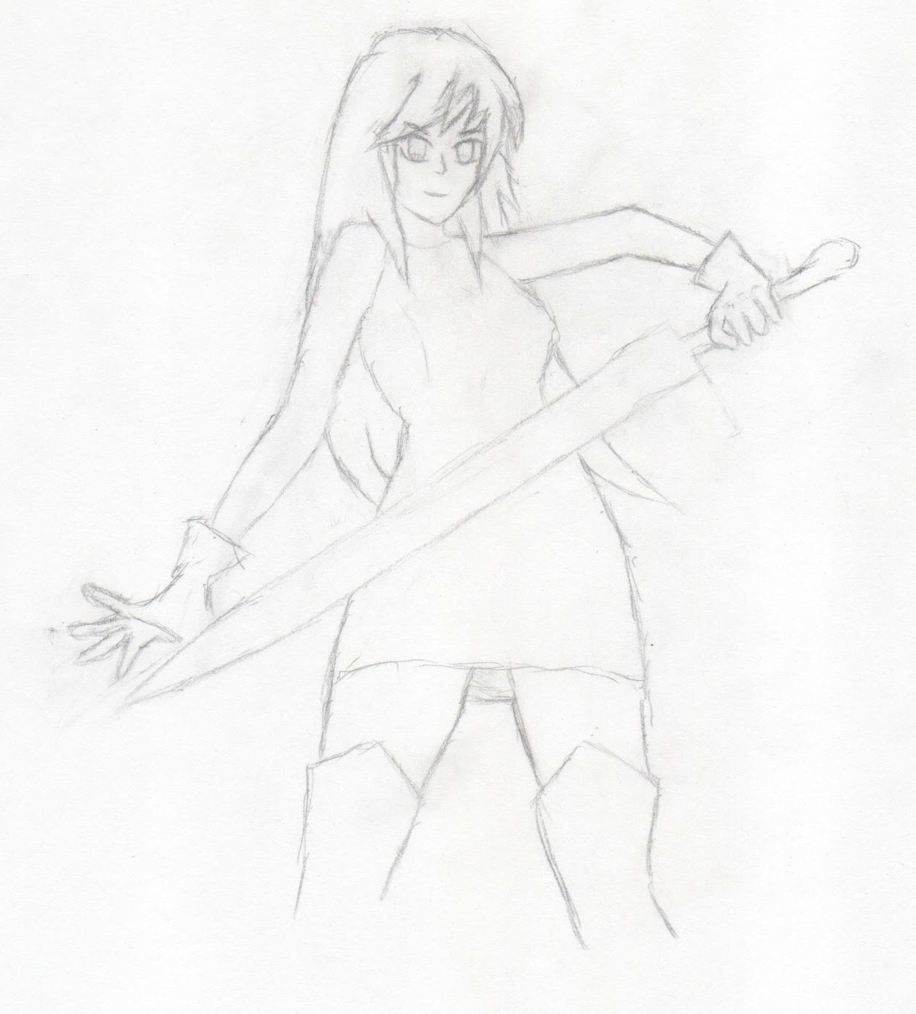
Characters
Jim
3 main characters in combat, 1 controllable in the overworld
Jim (Controllable in overworld)
Magic damage/support
Sophie
Tank
Crow
Physical damage
Currently using placeholder models
Crow
Sophie

Slide 4
Models
-Production for models began 2-3 weeks ago
-All models are created in Autodesk Maya
Currently Completed (non UV mapped models):
-Basic Pillar, Basic Enemy, Basic Human model (w/o head).

Slide 5
Overworld
Contains enemies that follow you in a certain radius for combat
Items on the floor to pick up and equip to upgrade stats of the characters
An NPC that provides you with side quests
Portals to move to other areas within the game
Day/night cycle in all non-battle levels
The two major maps so far are set in mountainous areas, plans to expand later
Currently using texture brush with weight-blended layer
Player navigates the world on the way to their next objective through portals and the maps themselves

Slide 6
Battle System
Turn based
Invisible “speed bar” fills
Resource system
Each character has their own resource that must be recharged
Currently limited to 5 moves per character
1 of these is a resource recharge, 1 is a “basic attack” which costs no resource
Currently enemies attack randomly

Slide 7
Save System
Currently can save in slots so the next time you load the game, your positions will be saved
Saves your position before entering battle so you exit where you entered
Saves your position when entering portals so you return where you were when you entered the portal when you return to the area

Slide 8
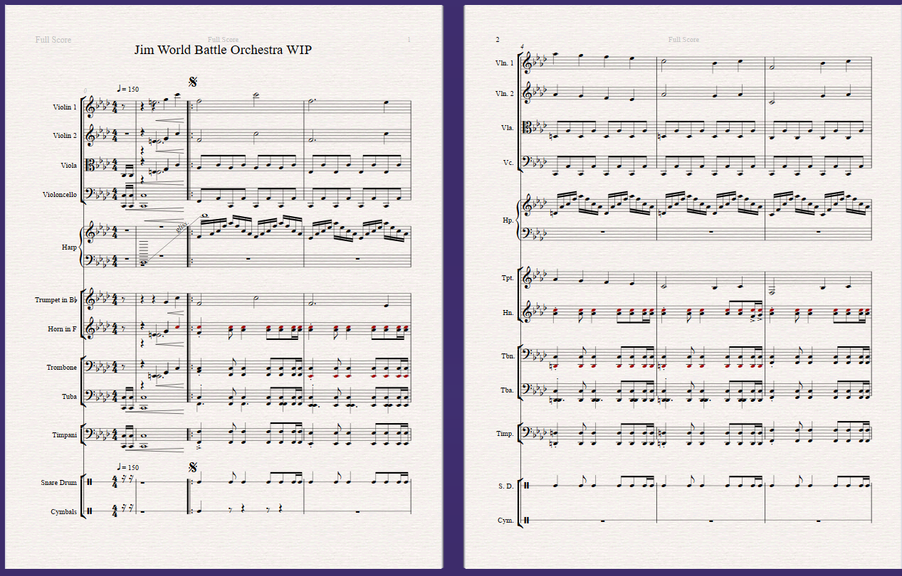
Music
Written in Sibelius Ultimate (free trial expired :( )
Remastered MIDI in FL Studio
Goals
Bring more emotion to the game
Characterize the world
Memorable, but not too annoying

Slide 9
Goals
Full Scale JRPG
Main story
Crafting system
Side quests
Expanded skills system (skill tree?)
Item use in combat
Full soundtrack
Every new situation should have its own soundtrack
Art
Character portraits, icons, item art, NPC art, etc.

Slide 10
Demo Notes
Long loading times upon entering battle
Battle system lags after killing things
Sometimes portals can be wonky
Lack of game balance
Equipping the items you will find on the ground will make you much stronger
The delay between maps is normal
The sun’s position is not saved between maps

Slide 11
What’s Next/Guidance?
Battle System
Menu navigation, how to store which menu you are in (Skills, Items, etc.)
Enemy AI logic and targeting
Overworld
Structures and buildings, especially large scale buildings (castles)
Texturing for the ground, how to add more variety and avoid obvious tiles
Music
Music notation software with more than 4 tracks? (preferably free)

Slide 12
What we need to add now
Story - Eugene? If not, Nick P
Finish quest system - Minjae
Models (human?) - Nick P
Music for different maps - Nick V (needs maps to go with it)
More maps -end me (Vincent)
Skill system? Items in battle? - Whoever finishes first (nick v)
Day/night timer save - Nick V (IM DONE NOW)
FOCUS ON TIME SYSTEM (pressure on jprg? story, gameplay, etc.)

